Slide 1
Team 10 Tensiometer Design Project
Derren Lyons, Bailey McElhinney
Notes:
ID=d924773e-9a16-4d6d-9803-8cb819e99682 Recipe=text_billboard Type=TextOnly Variant=0 FamilyID=AccentBoxWalbaum_Zero

Slide 2
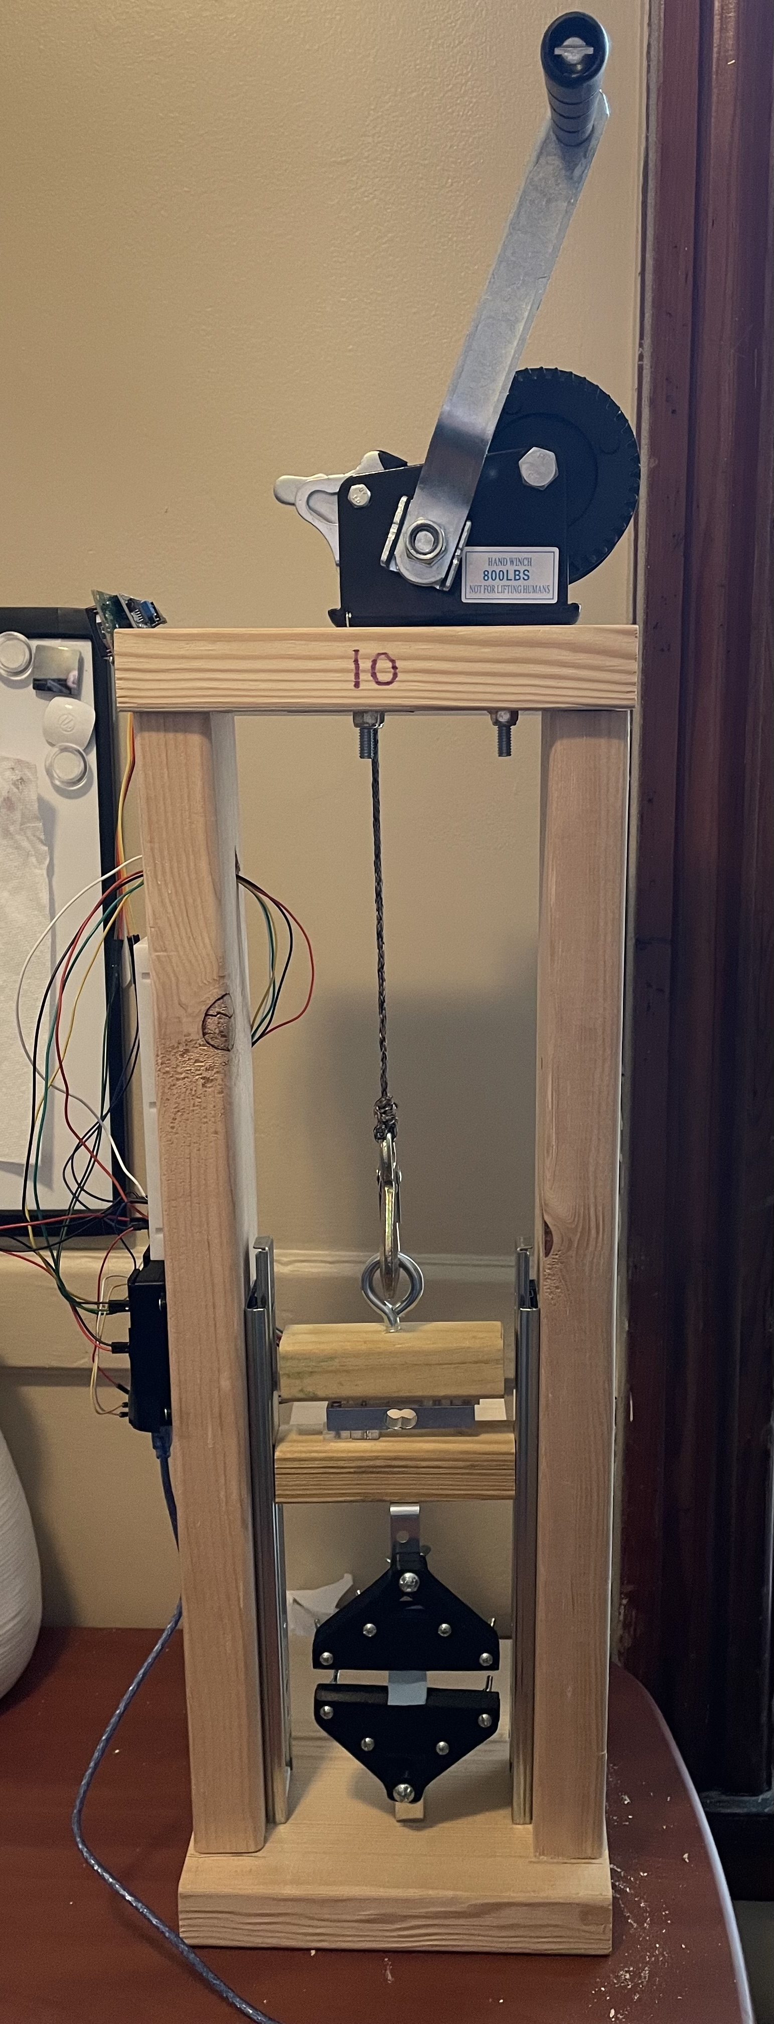
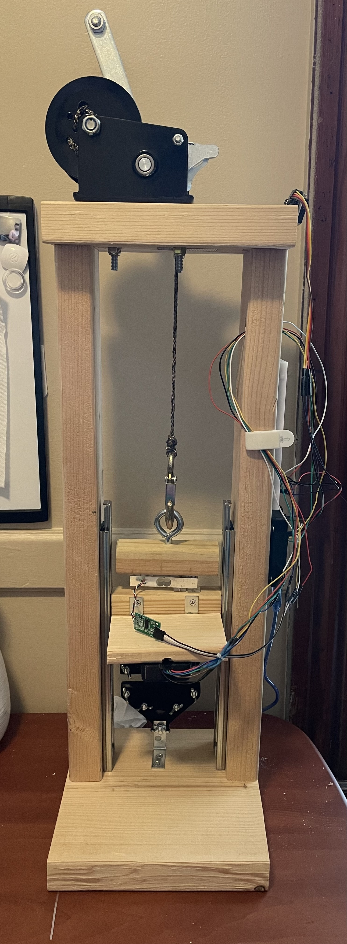
Objectives
System Accuracy
System Ease-of-Use
Budget Friendly Design

Slide 3
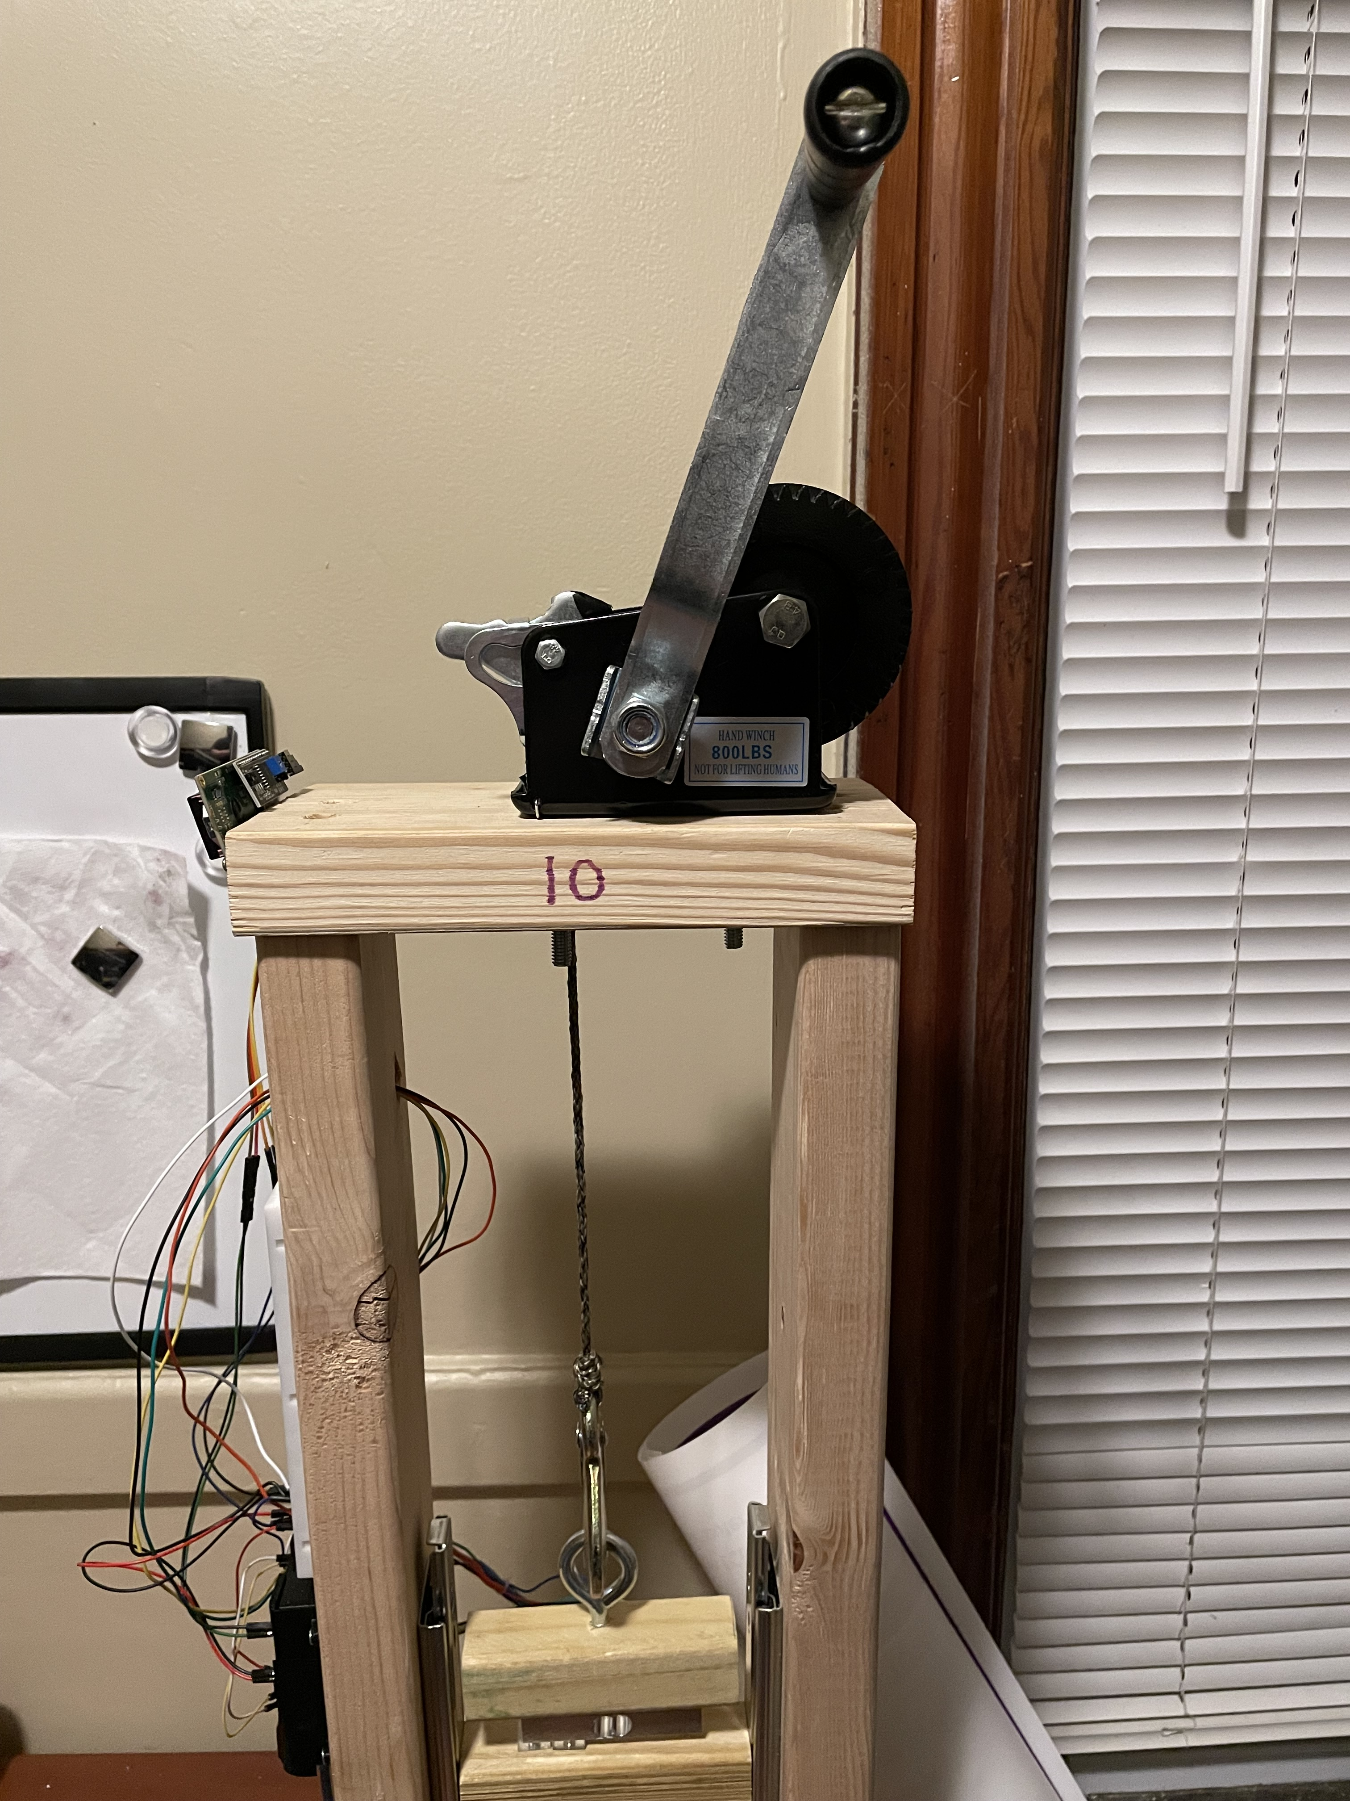
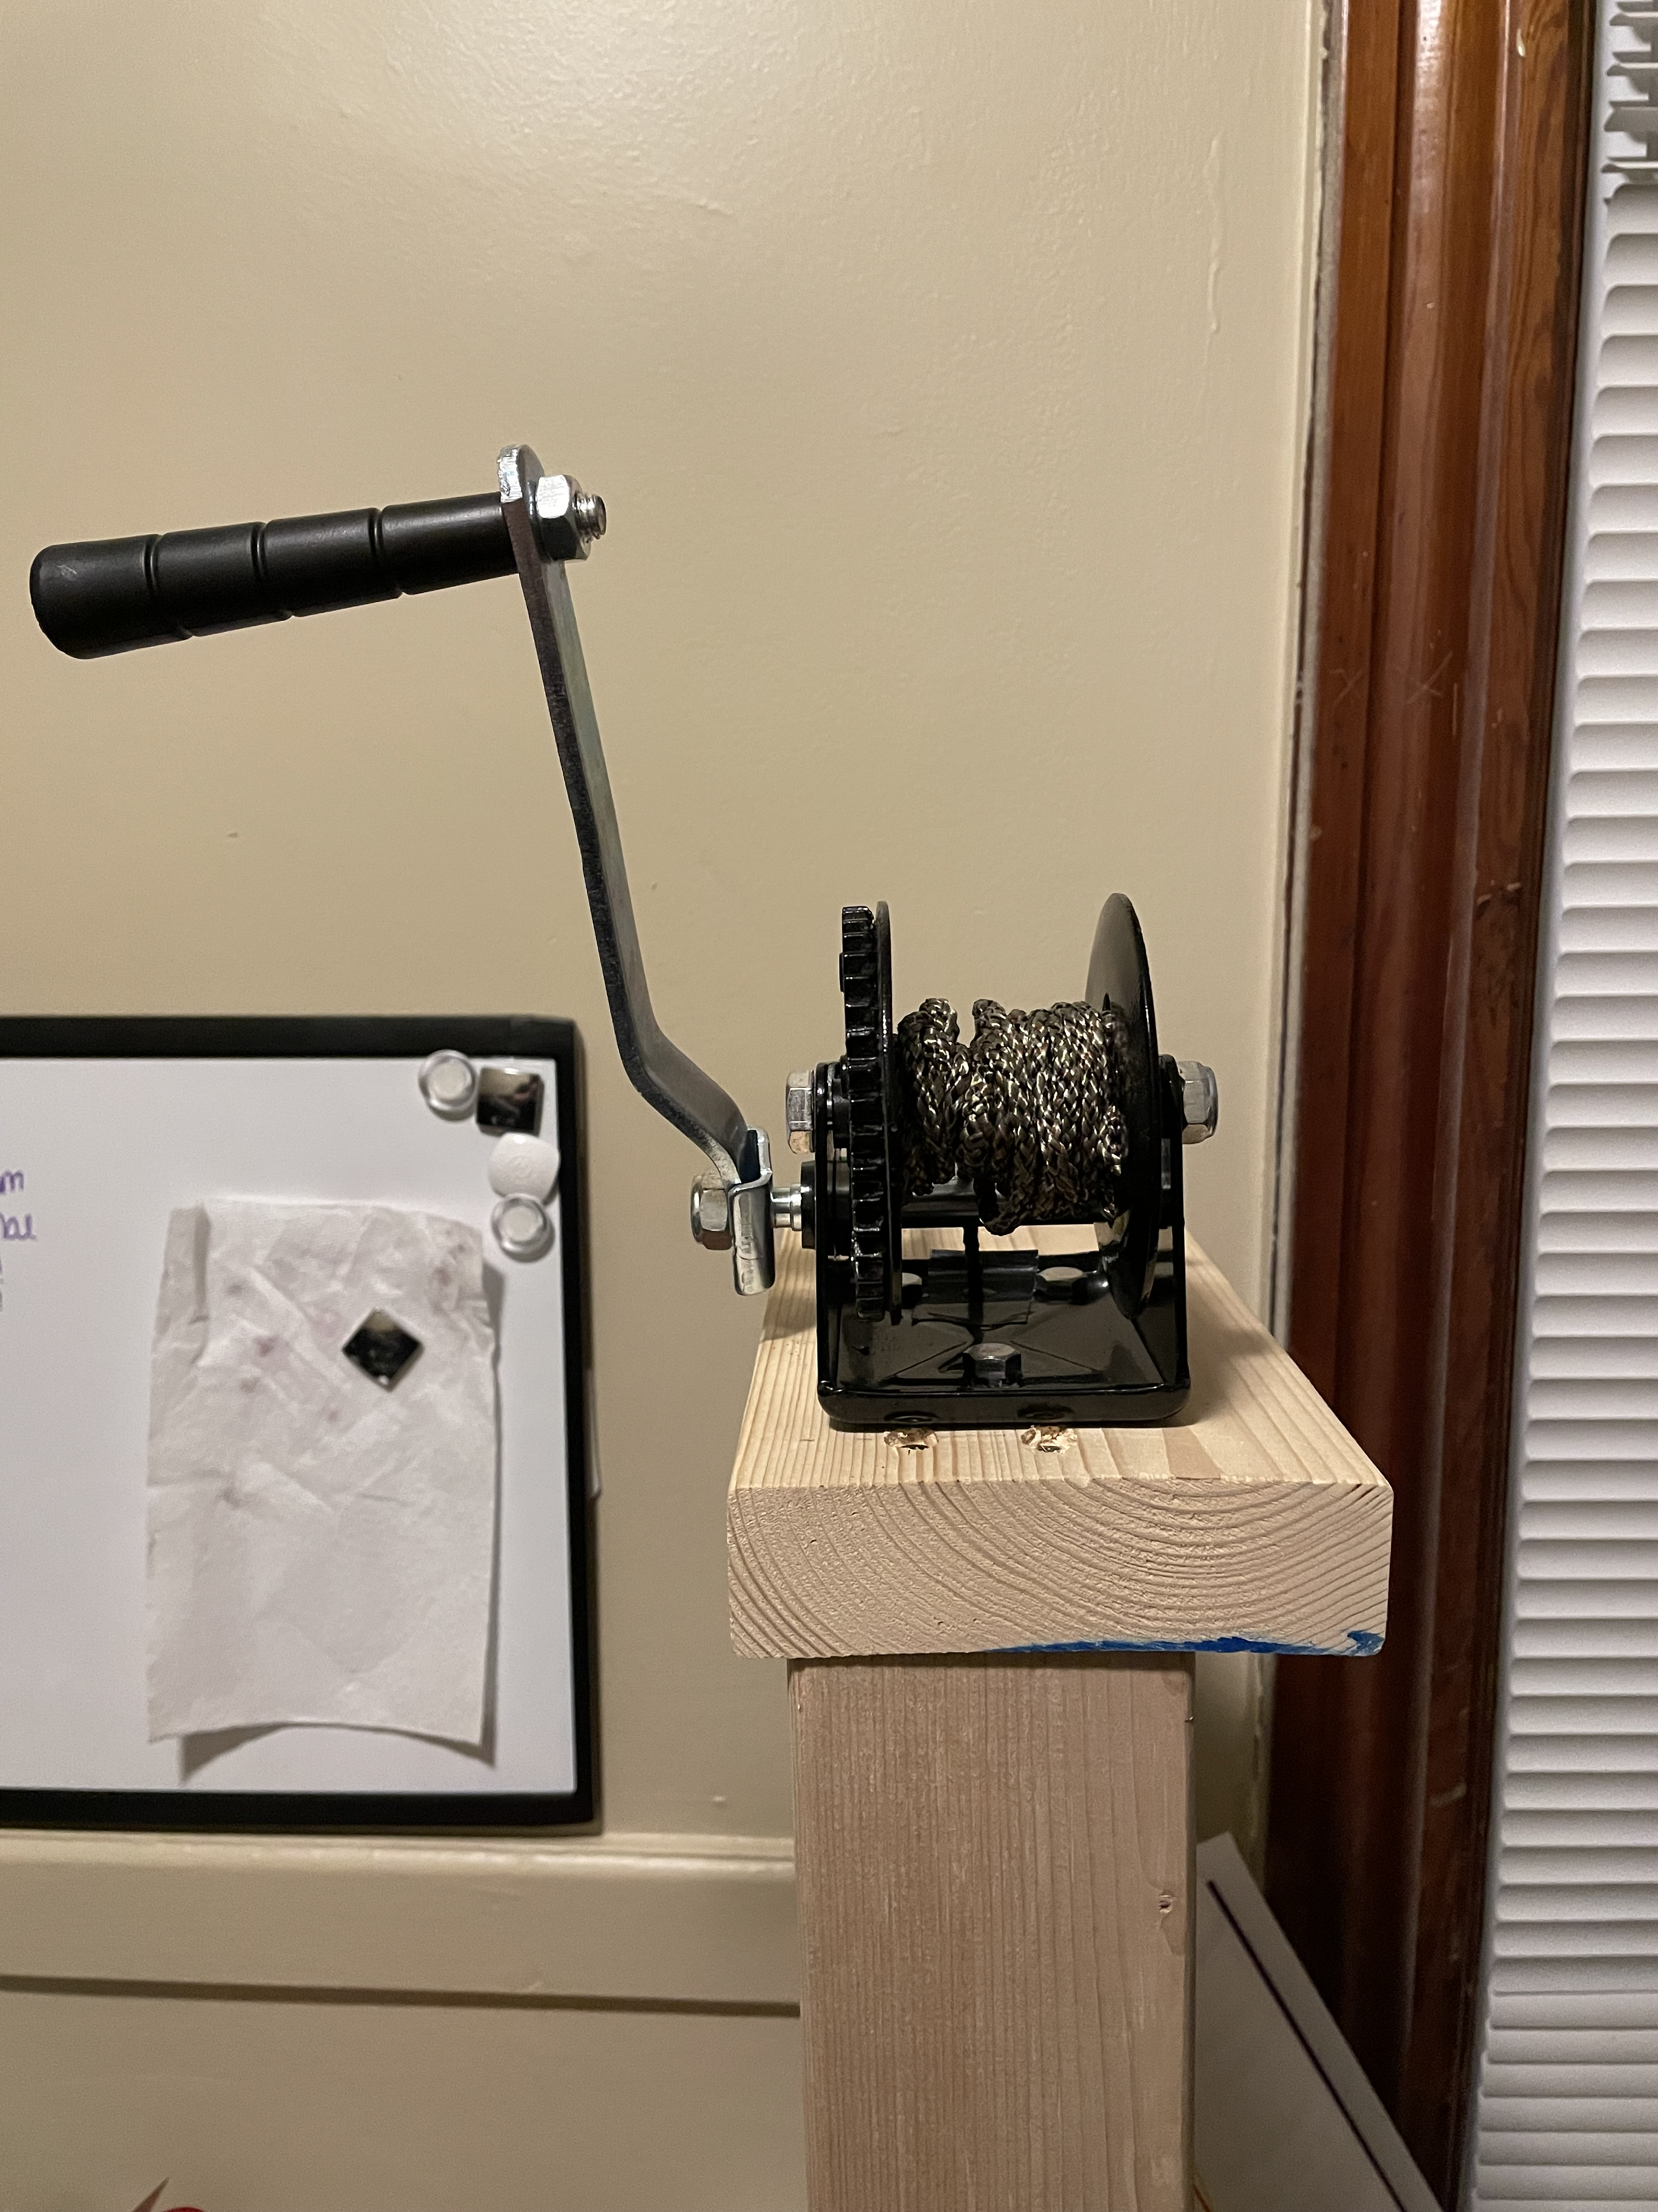
Heavy-Duty Hand Winch
Functionality
Implemented for a smooth controlled pull over the course of a trial
Rope installed with it has no give which could affect stress measurements otherwise
Holds clamps in place if user stops cranking

Slide 4
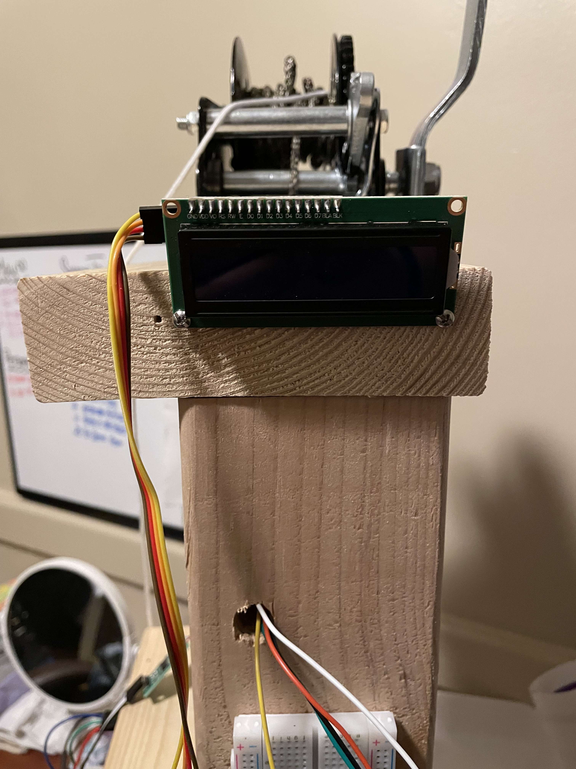
LCD Display
Functionality
Can easily see stress and distance displayed prior to and during a trial
Guides the user in error detection
I2C protocol eliminates complicated integration with the existing system

Slide 5
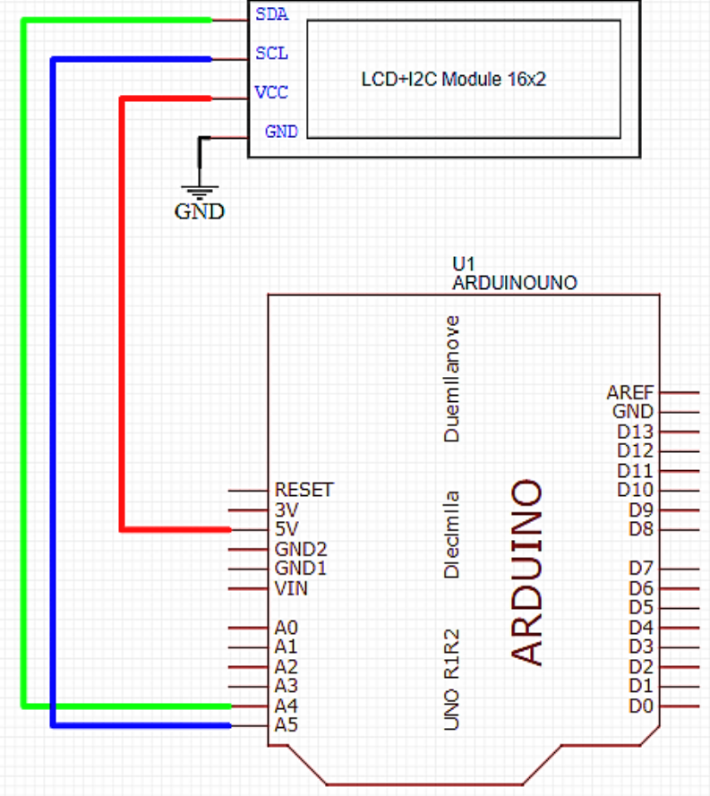
LCD Display
Circuit Illustration

Slide 6
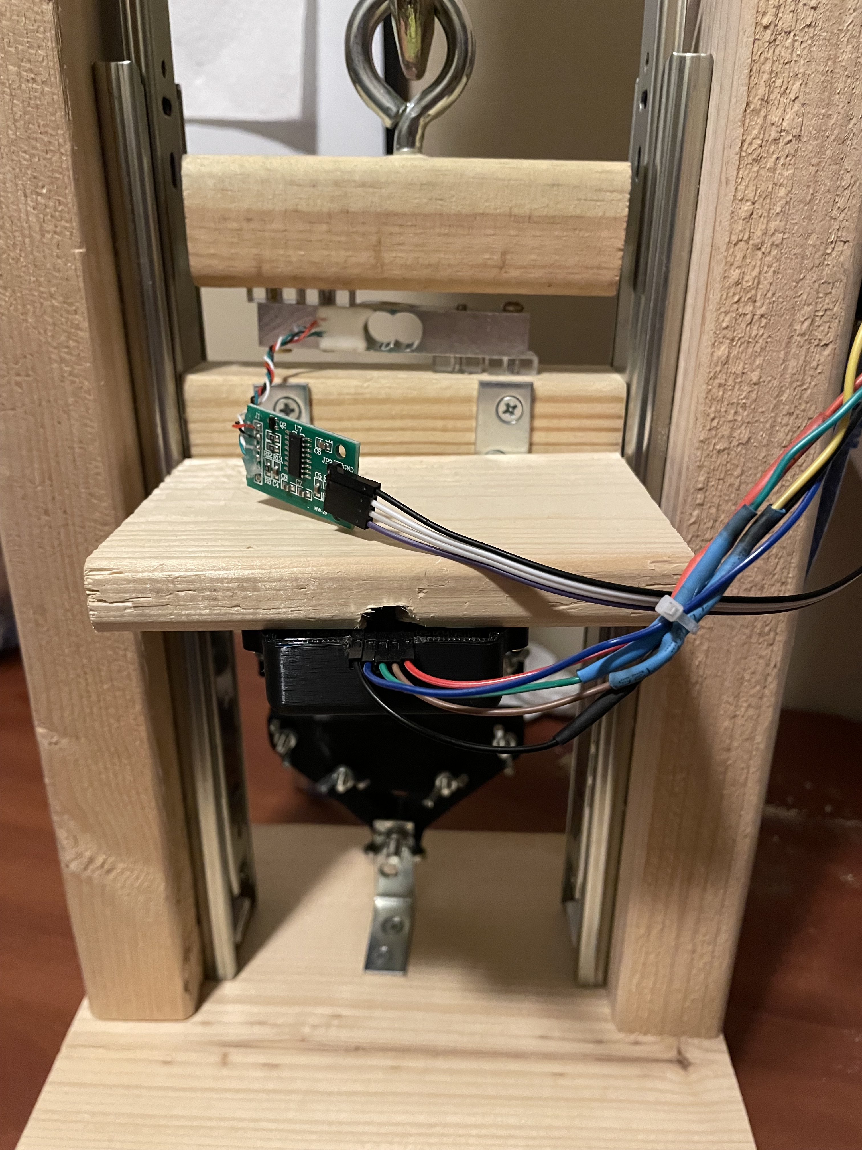
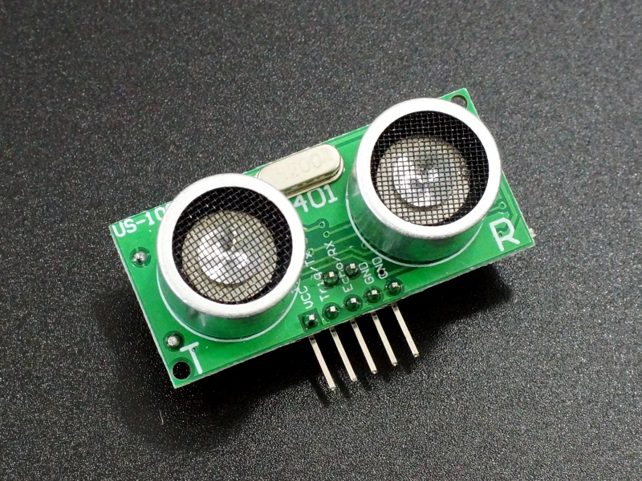
US-100 Ultrasonic Range Sensor
Functionality
Improves accuracy in distance measurements over previous sensor, by measuring the temperature to use a more precise speed of sound measurement.
Eliminates erroneous outputs that would affect the stress-strain curve

Slide 7
Experimental Results

Slide 8
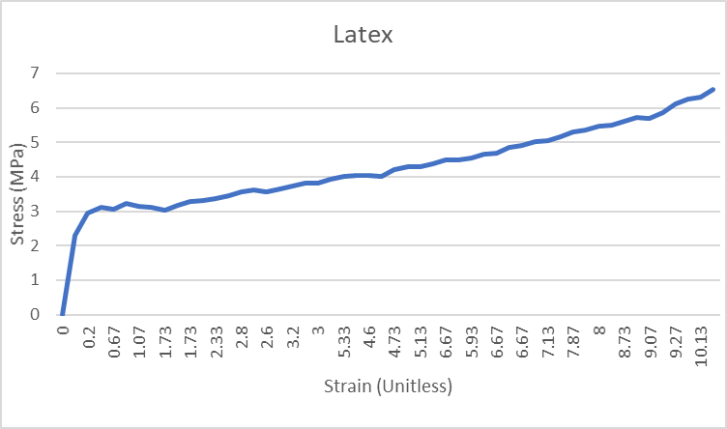
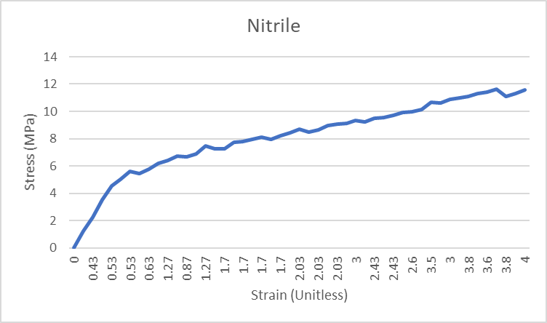
Stress-Strain Curves

Slide 9
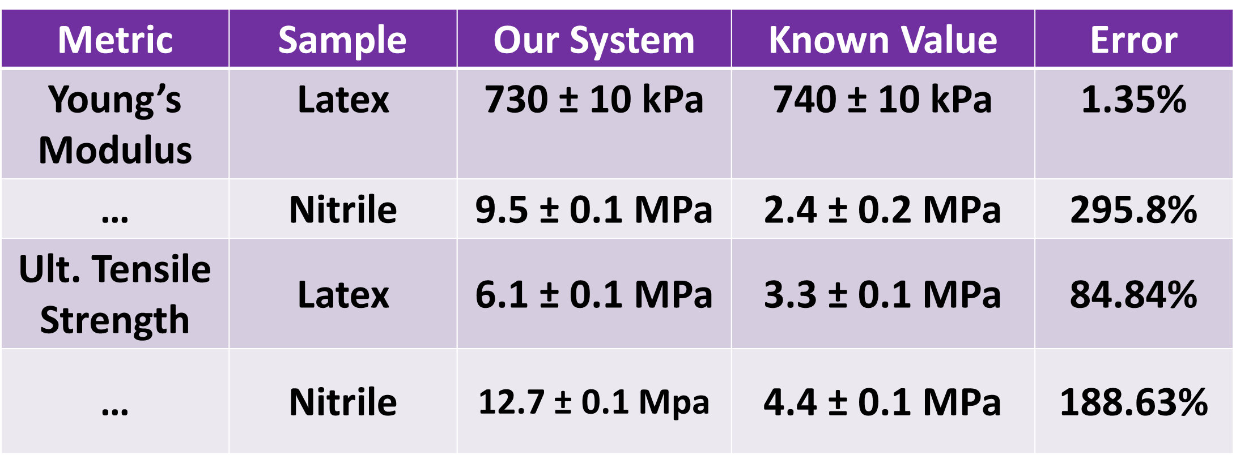
Aggregated Results

Slide 10
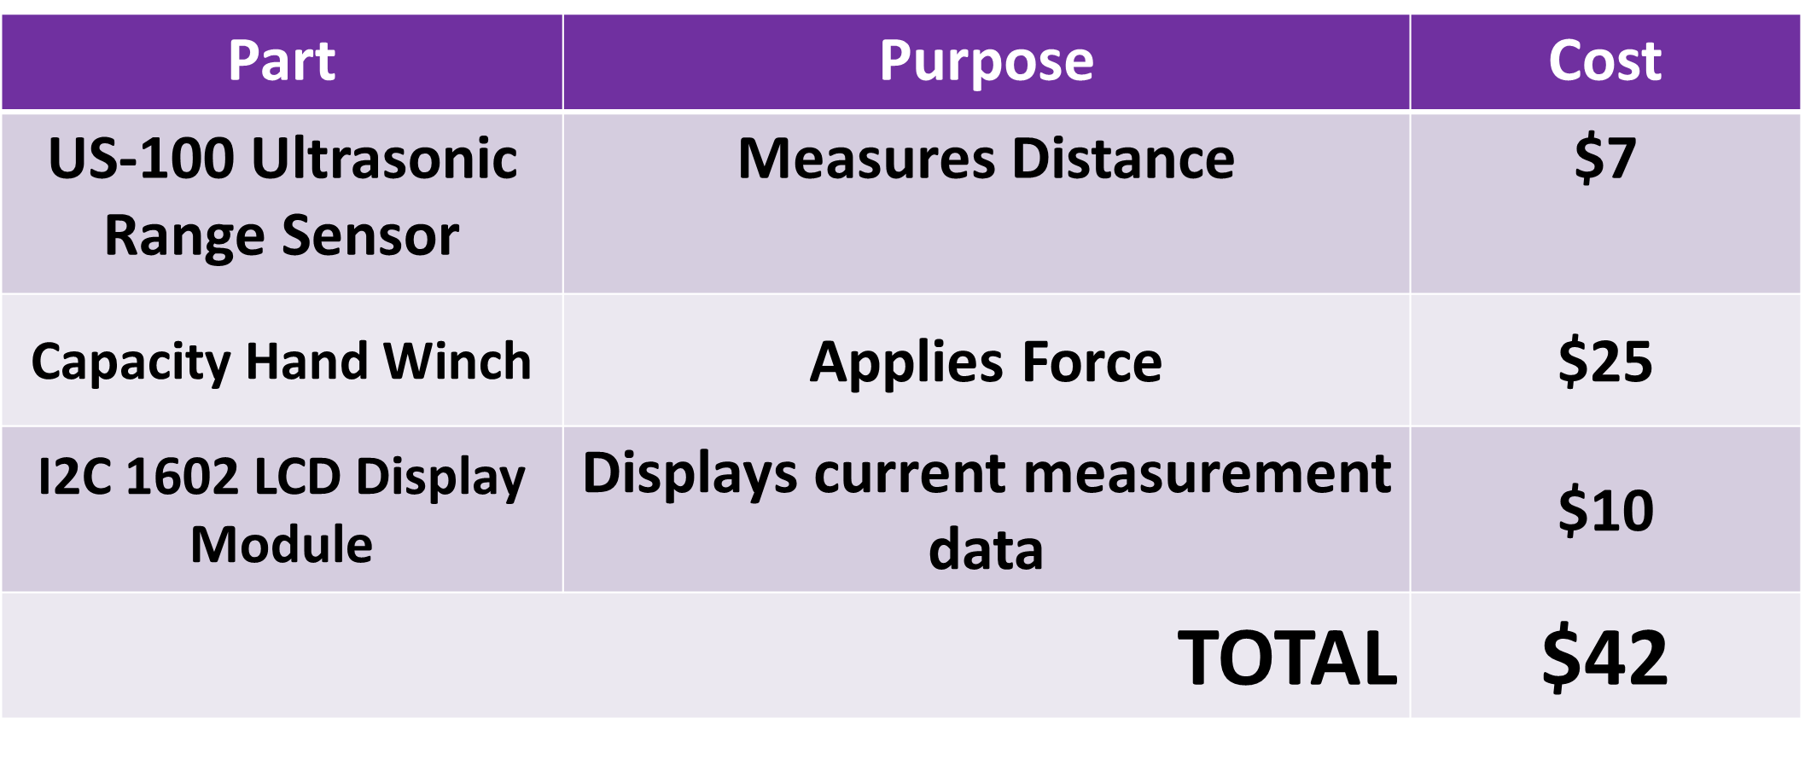
Budget

Slide 11




Thank you

